Slide 1
SPRINT 3 DEMO – CCP TOUR APP
Gerardo Flores, Ahram Kim

Slide 2
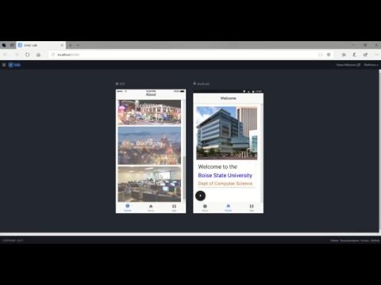
Notes:
This happened because we initialized a new github repo with README or LICENSE file. We should have to merge those new initialized files with our work. ‘git pull’ fetches and merges.

Slide 3
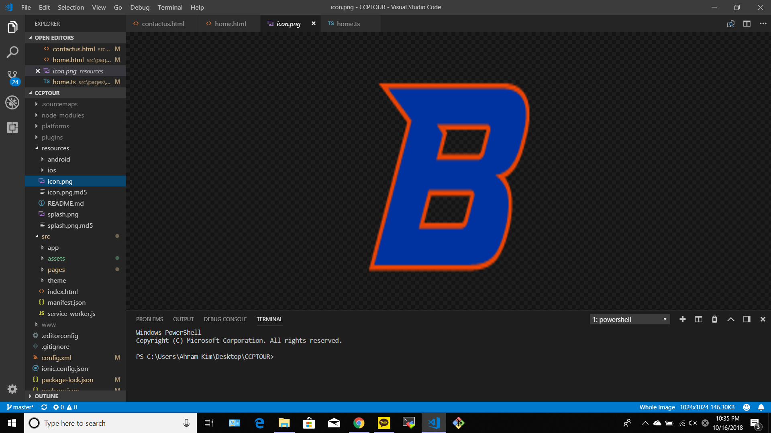
Icon Logo

Slide 4
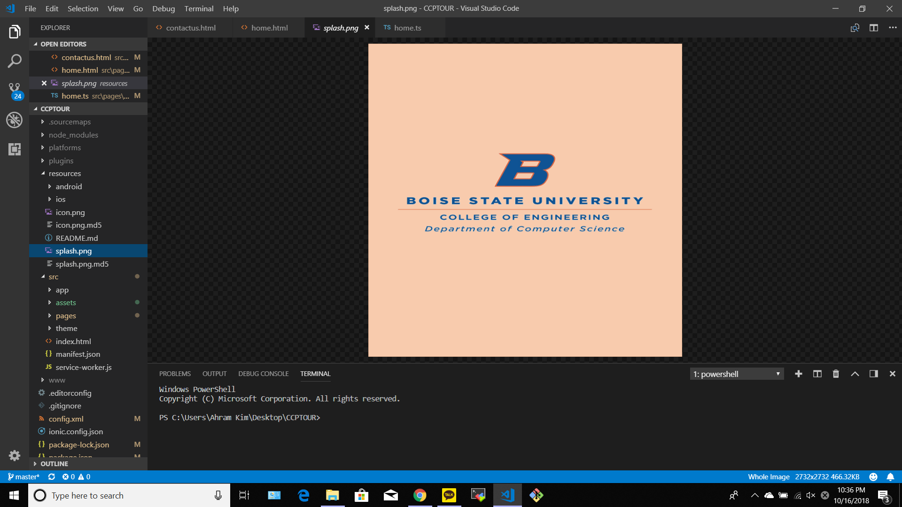
Splash screen Logo

Slide 5
DEFINITION OF DONE
All acceptance criteria have been met
We redesigned splash screen and icon
We start the ‘about’ tab for the user
All the automated tests for the user story run without failing and any defects
We have tested to connect to Ionic framework and not found any defects
Code unit tested
Pair programming is done
Build pushed to demo server

Slide 6
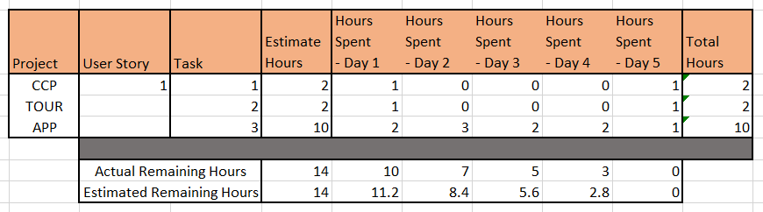
BURNDOWN CHART

Slide 7
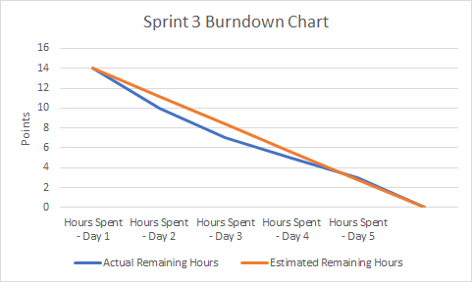
BURNDOWN CHART

